Slide 1
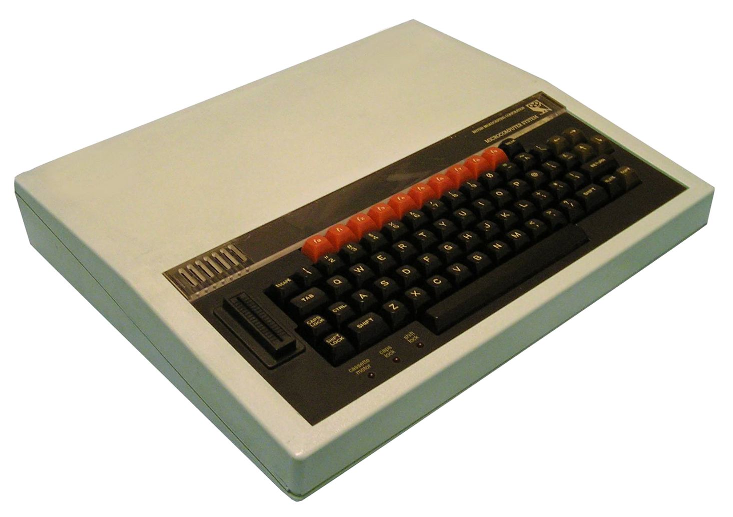
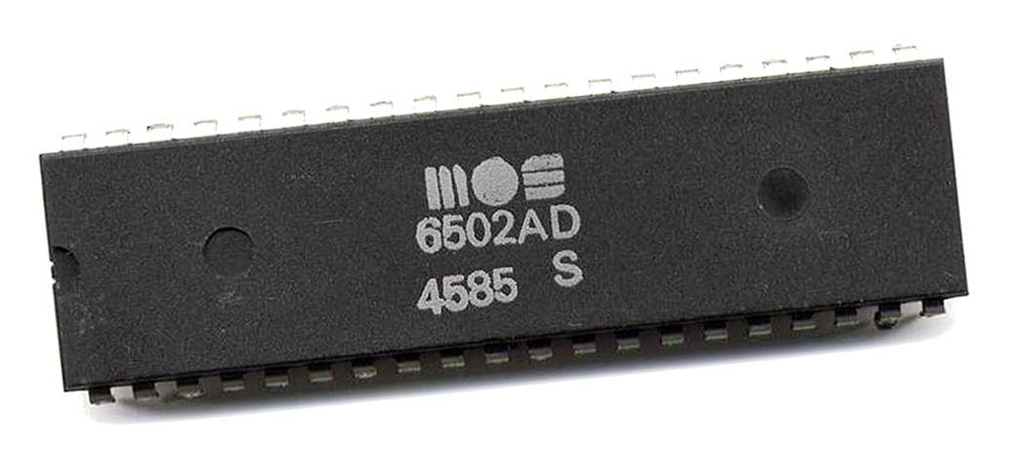
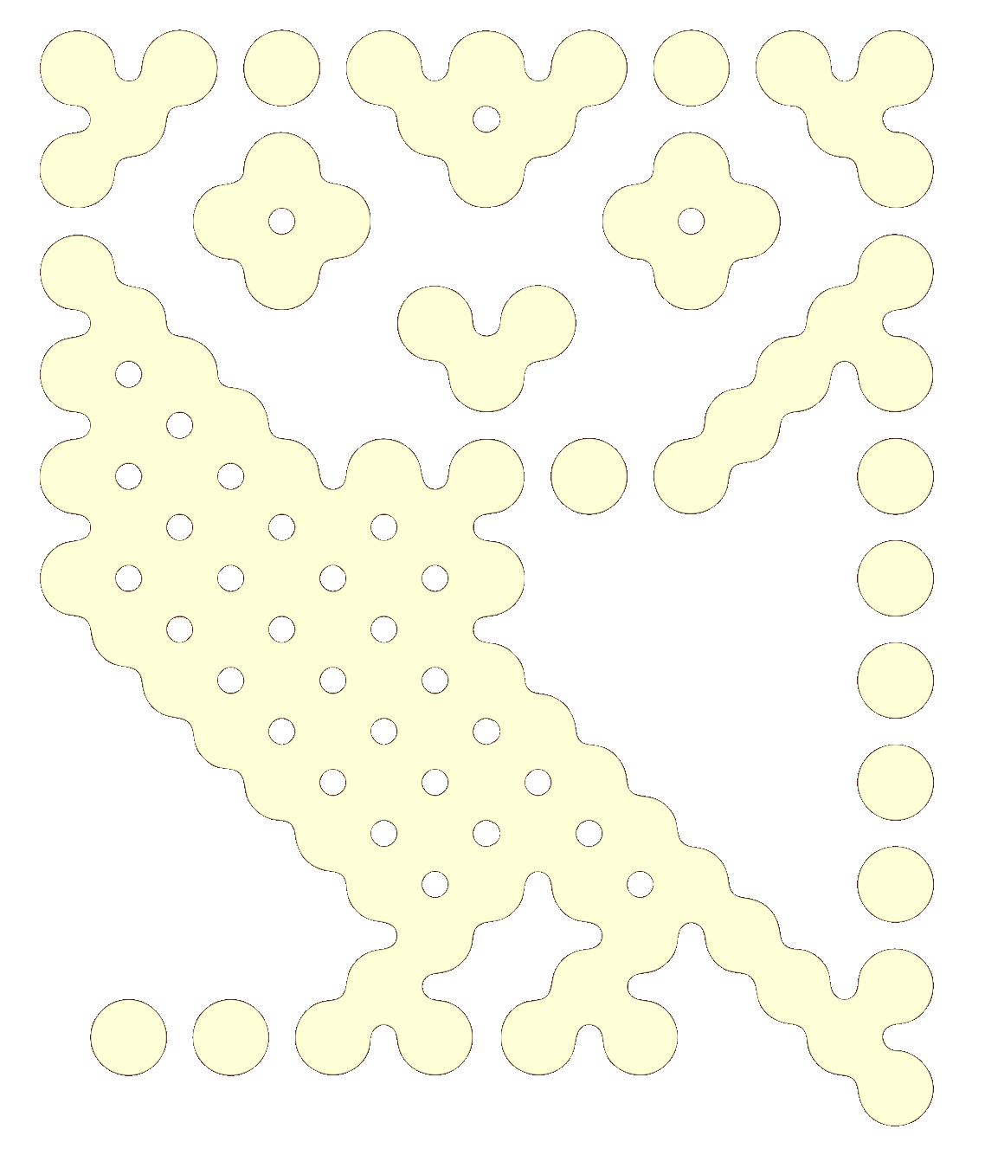
Towards Emulation of the BBC Micro Computer

Slide 2
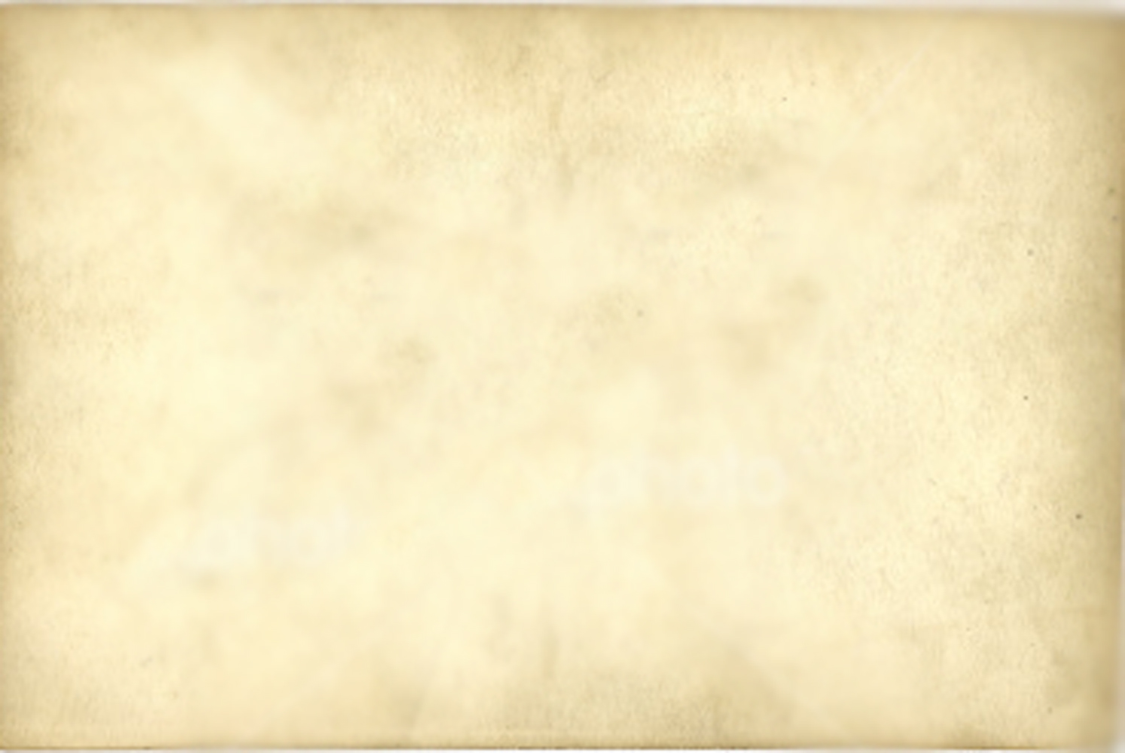
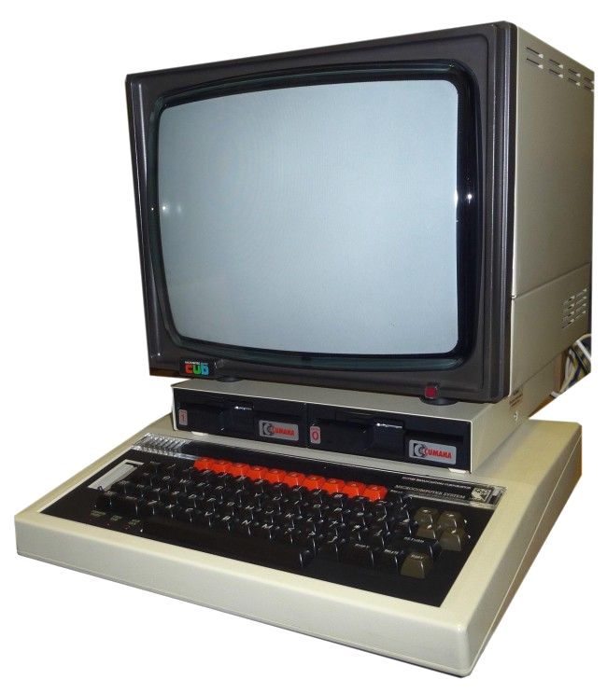
Some History
BBC Computer Literacy Project
Launched 1981
Manufactured by Acorn
2 MHz MOS Technology 6502/6512
RAM 16–32 KiB
Graphics - 6845 CRTC
8 Modes
160 × 256 8 Colours 640 × 256 1 Colours, Teletext
Sound – Texas Instruments SN76489 ADSL

Slide 3

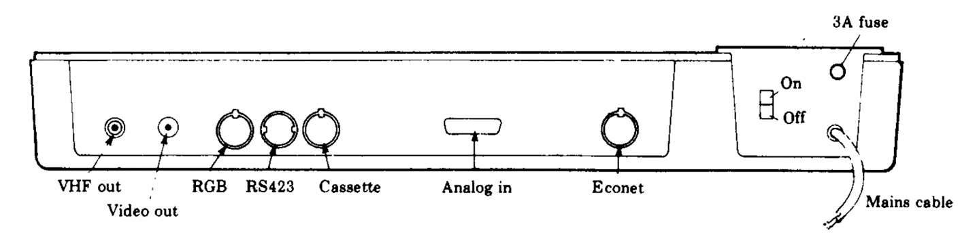
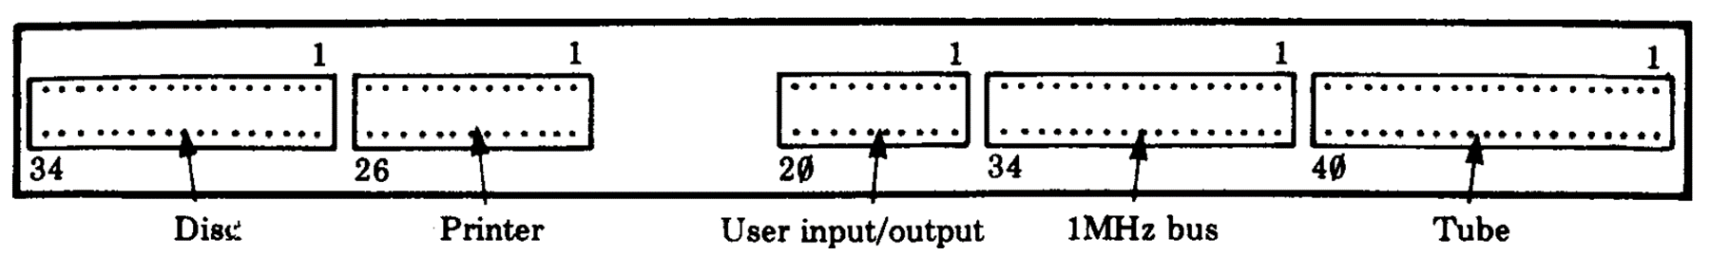
Expansion

Slide 4
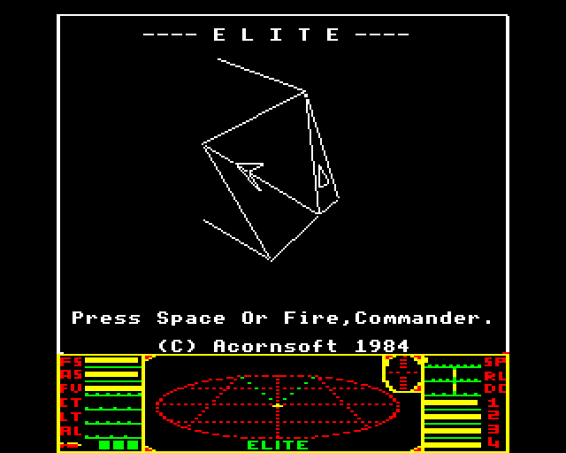
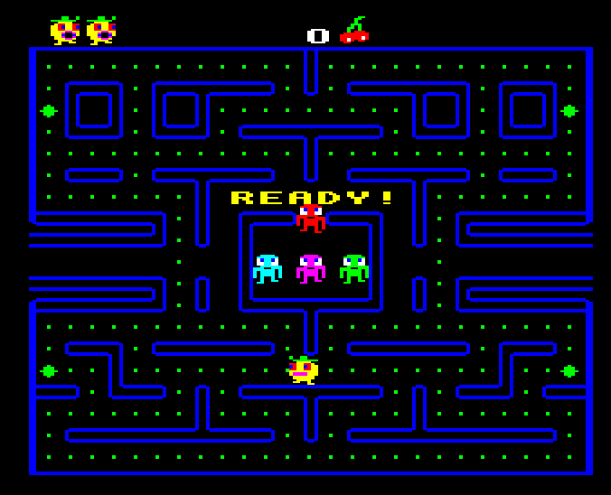
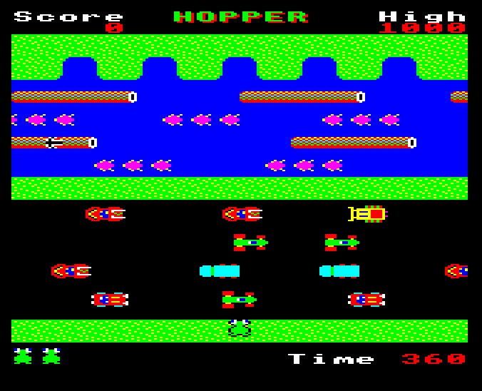
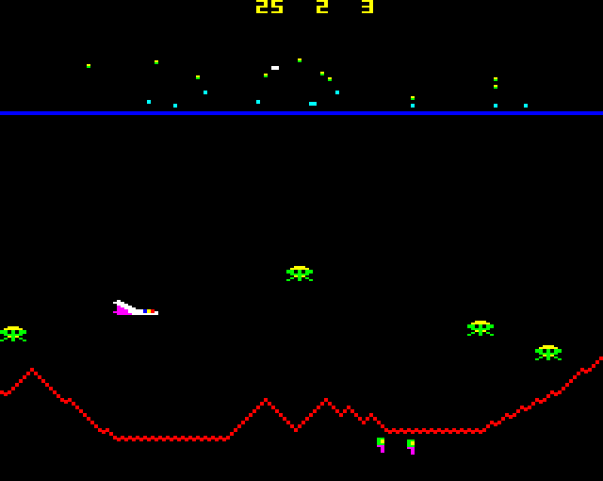
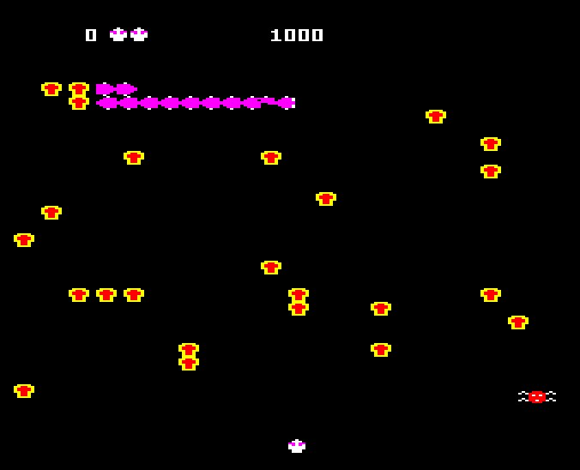
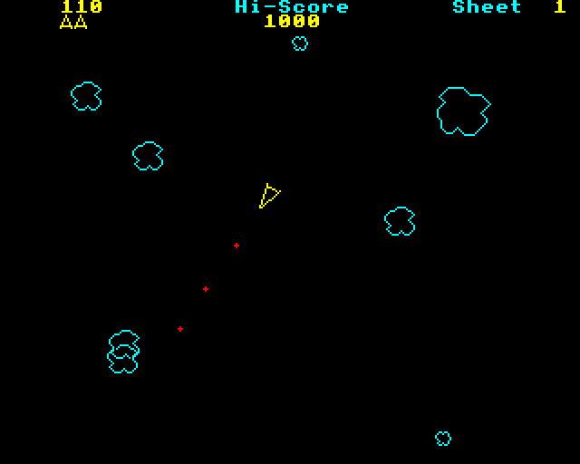
Software - Games
Elite
Pacman (Snapper)
Frogger (Hopper)
Defender (Planetoid)
Centipede (Bug Blaster)
Asteroids (Meteors)

Slide 5
Software - other
Languages (ROMS)
Basic, Pascal, Forth, BCPL, LISP, Logo/Turtle graphics
Business
Word processors (Wordwise), Spreadsheet (ViewSheet), Accounting, Database
Educational
Maths, Physics, Electronics, Geography, Chemistry

Slide 6
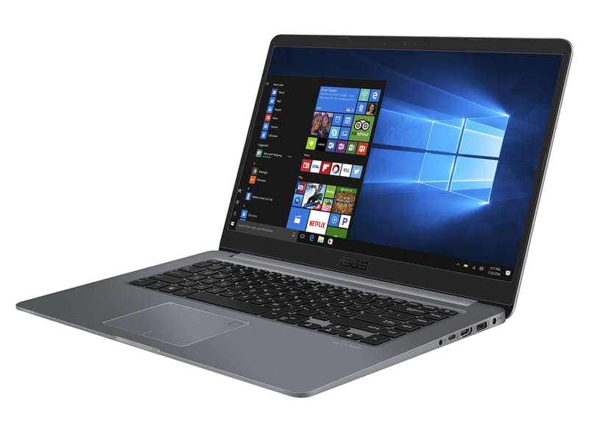
An Emulator you say…
Allows software written for one type of computer to run without modification on another…
… by recreating the hardware of the old system as software on the new system

Slide 7
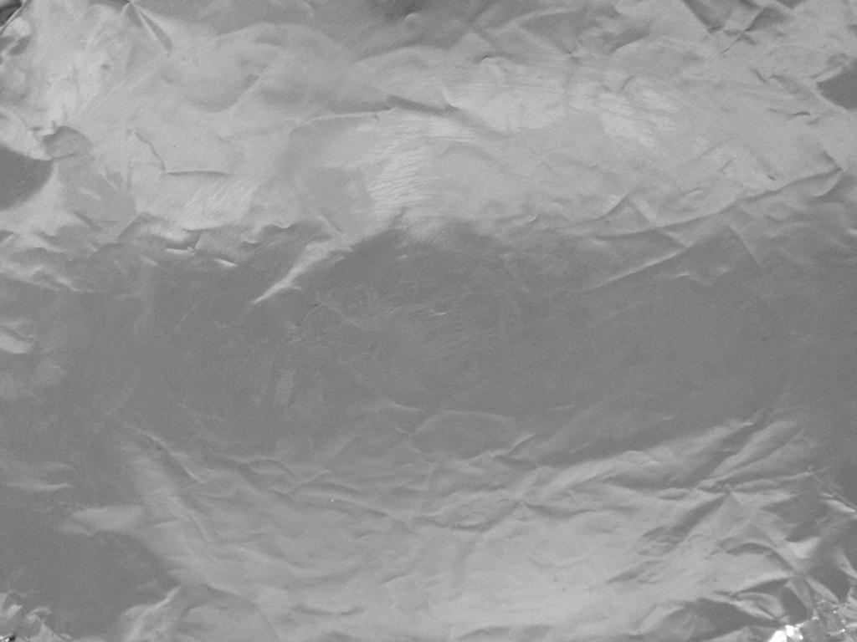
Step 1
CPU
Memory
Basic I/O

Slide 8
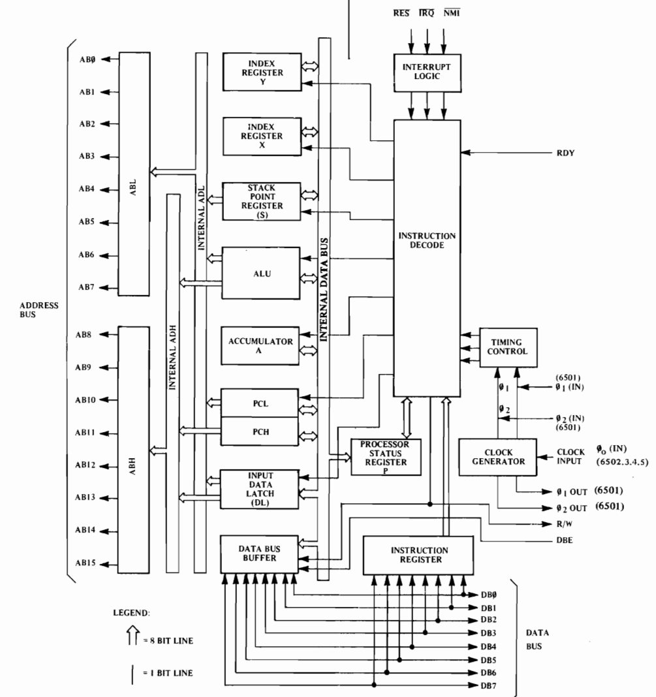
The 6502 Microprocessor
Clock speed – 2 MHz
Transistors - ~3500
Buses
Data – 8 bit
Address – 16 bit => 64K address space
Registers
1 Program counter (PC) 16 bit
1 Stack pointer (S) 8 bit => 256 byte stack!
1 Status register (P)
1 Accumulator (A) 8 bit
2 Index registers (X,Y) 8 bit

Slide 9
Aside – comparison with a modern system

Slide 10
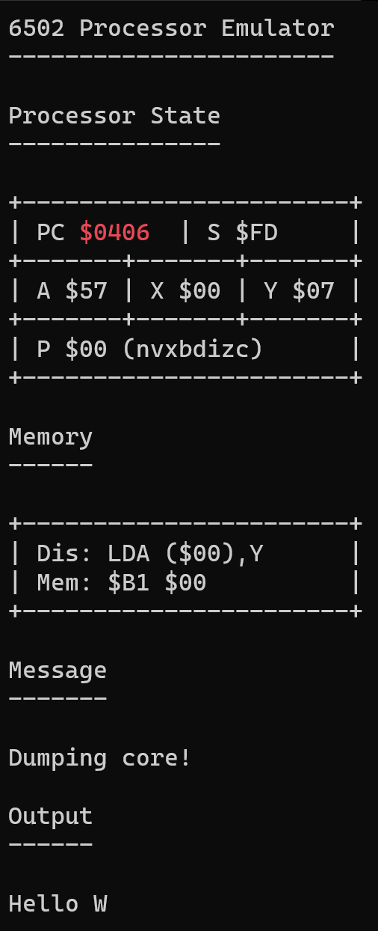
Single step
Run to completion
Dump core
Exit
Registers
Current instruction
Emulator messages
Program output

Slide 11
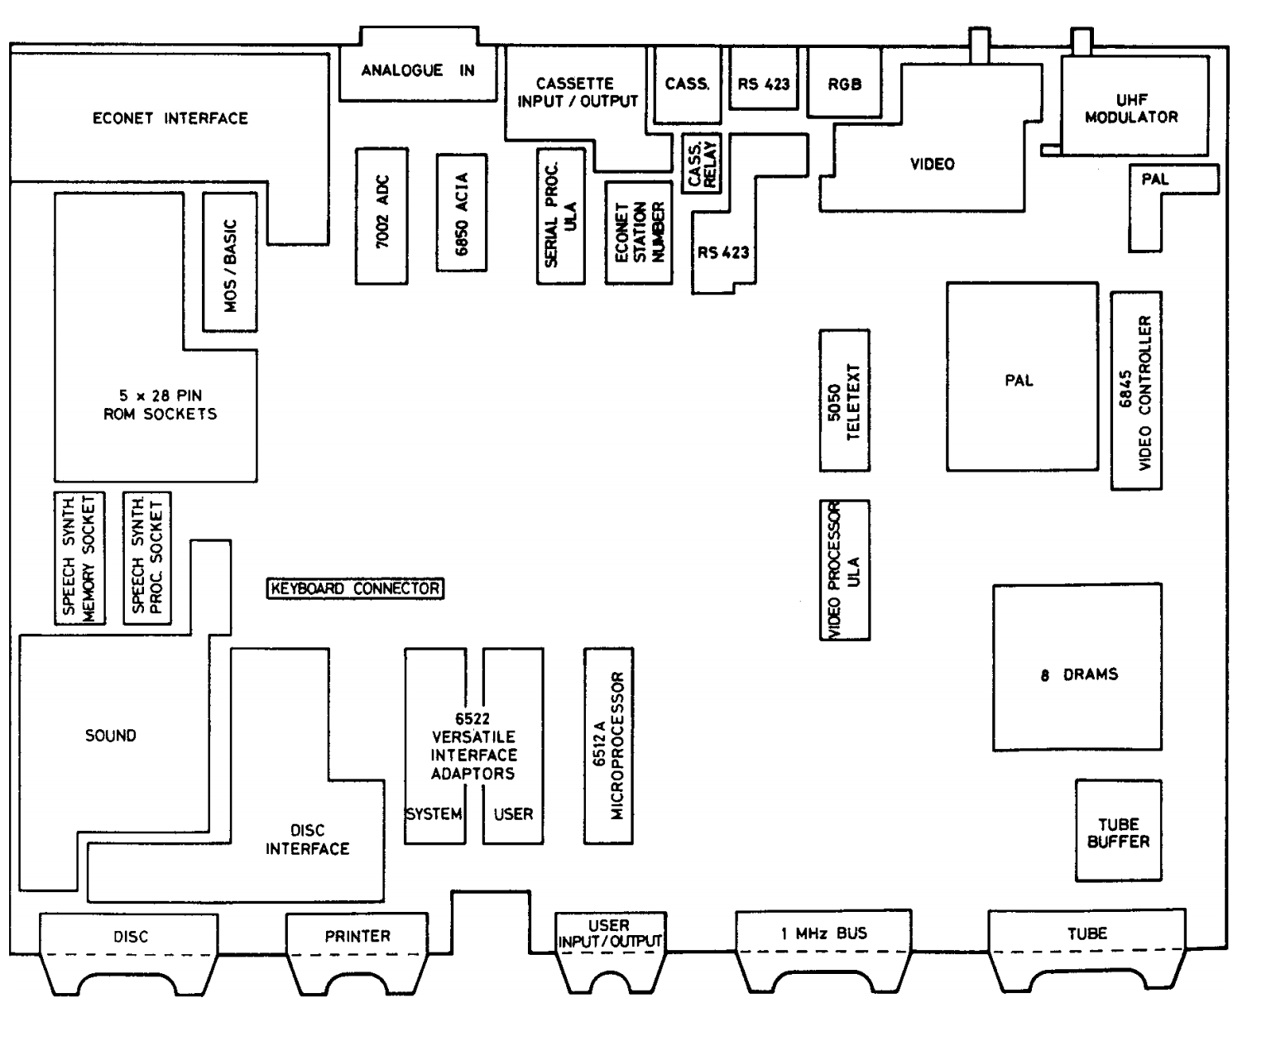

Slide 12
